Slide 1



Review Coffee by Scrapping

Slide 2
Project task
Scrape data from web site Cooffee Review
01
Cleaning and wrangling data Data in Phyton
02
Create visuallizations in Python and tableau
03

Slide 3

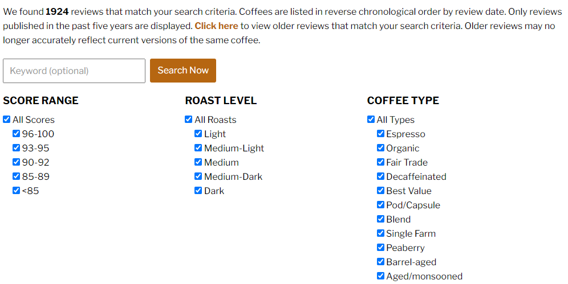
Scrape the data

Slide 4
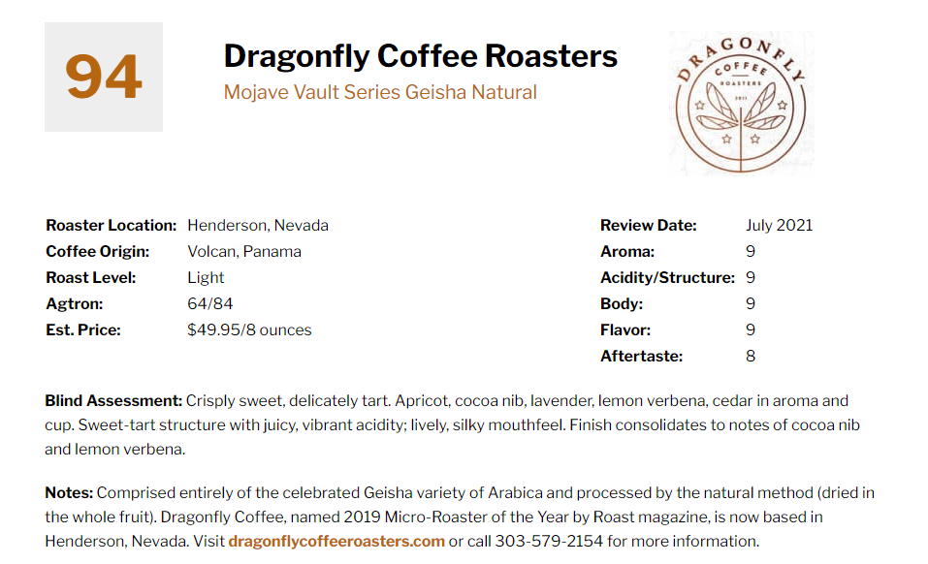
Review For Data Scrapping And Collection

Slide 5
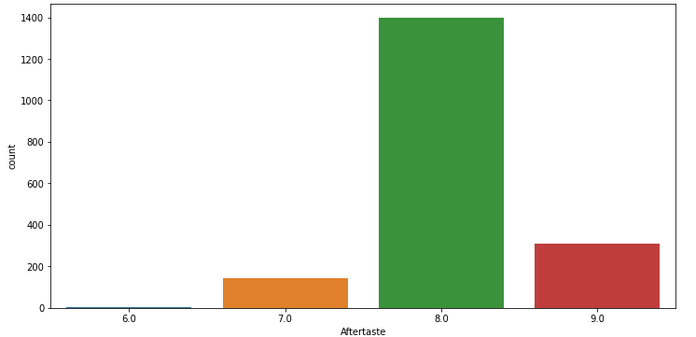
Classification by Features Aftertaste

Slide 6
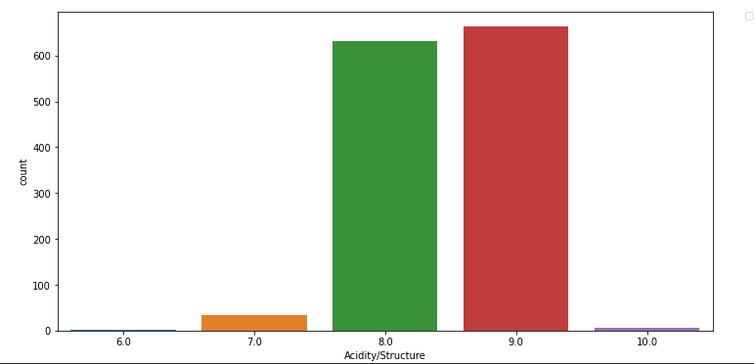
Acidity/Structure

Slide 7
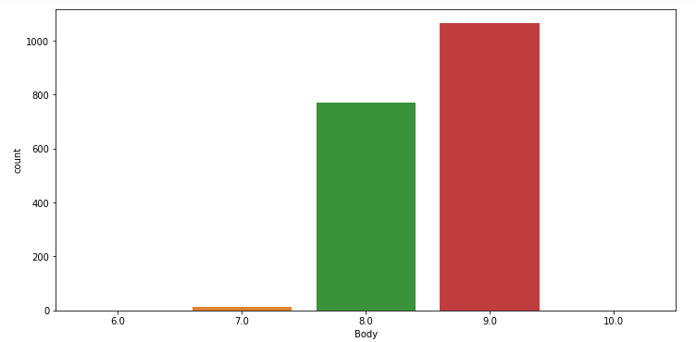
Body

Slide 8
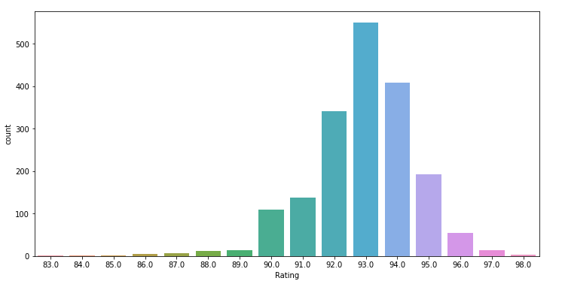
Count of Coffees by Punctuation

Slide 9
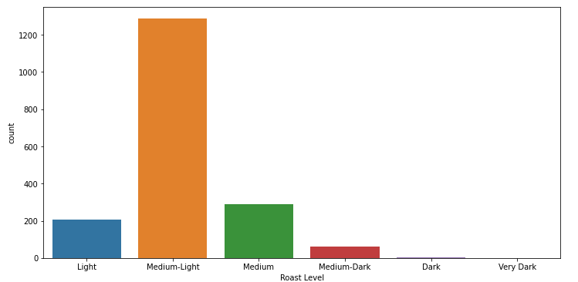
Count of Coffes by Roast Level

Slide 10
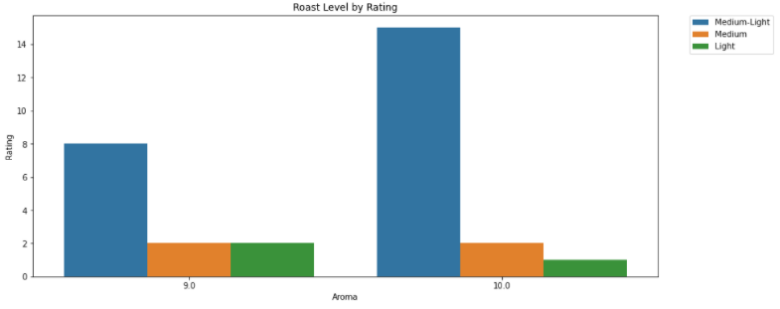
Aroma Level By Rating

